Slide 1

Boston Housing Data Analysis

Slide 2




Team members:
01
02
03
04
Patricia Tating
Milkah Nyaingo
Bemba Munkhchuluun
Maryam Gadimova

Slide 3
Contents
Exploratory Data Analysis​
Model Building and Comparison
Model Evaluation
Residual Analysis
Testing Utility of the Model
Prediction & Confidence Interval

Slide 4
Study Objectives
What factors have the most significant impact on the median value of homes in the Boston area?
Which predictive model most accurately forecasts housing prices based on the available dataset features?

Slide 5
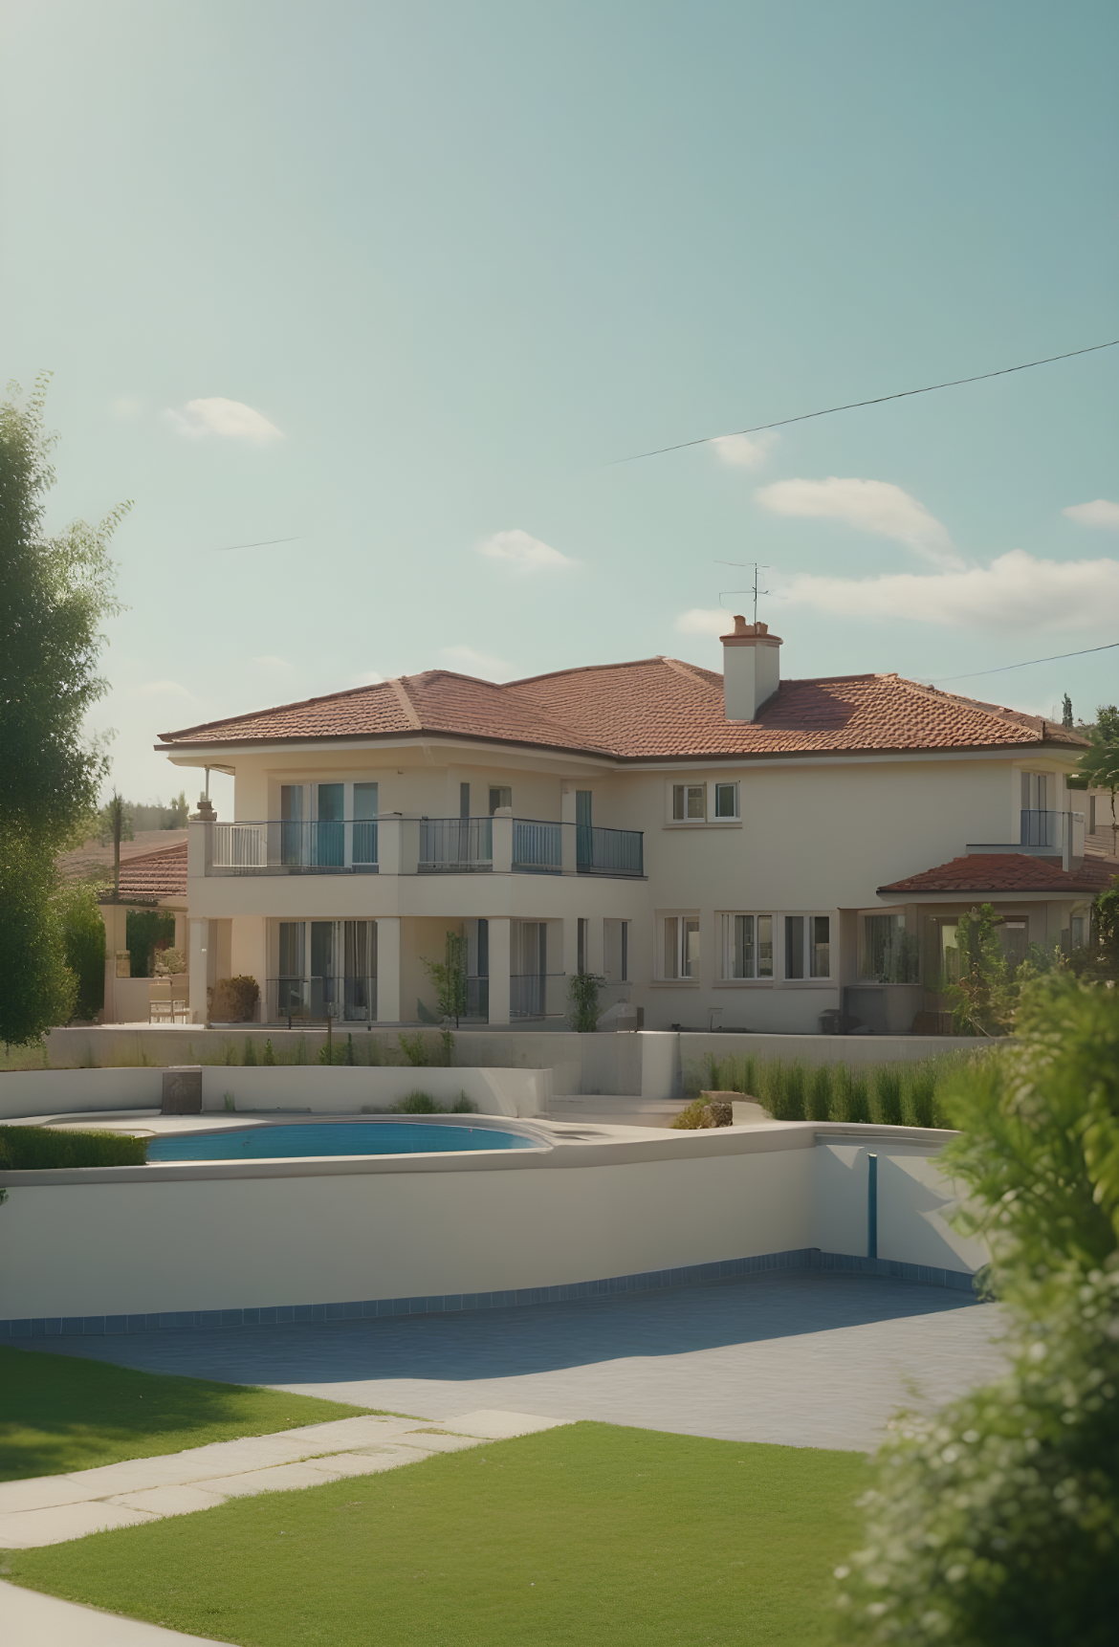
Exploratory Data Analysis

Slide 6
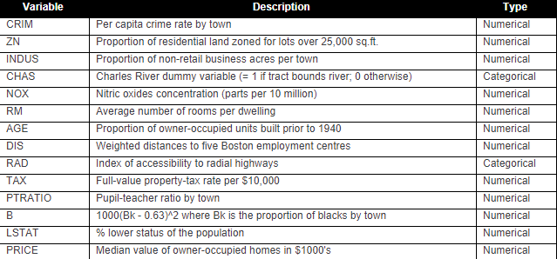
506 Observation
Original Dataset
14 Variables
Training (90%)
Testing (10%)
455 Observations
14 Variables
51 Observation
14 Variables

Slide 7
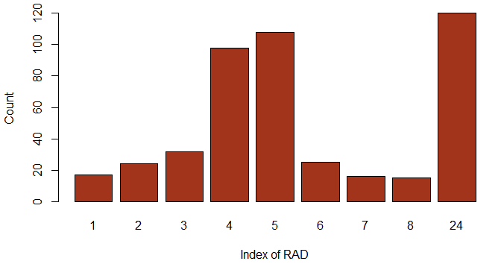
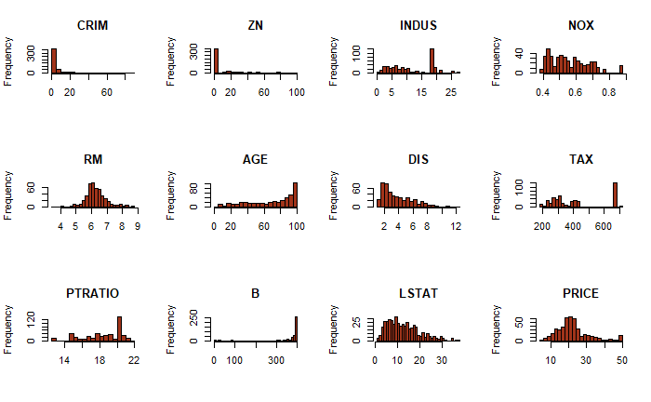
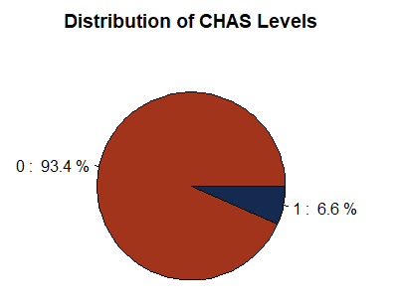
Histograms of Variables
2 Categorical
12 Numerical

Slide 8
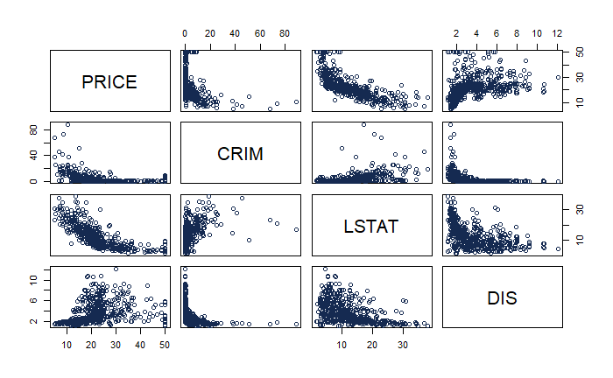
Pair Plot of Variables

Slide 9
Model Building and Comparison

Slide 10
Model Summary
NAME | NOTES | R_{A}² | EXPLANATORY VARIABLES
Fit1 | Full model All 13 variables. | 0.745 | CRIM+ZN+factor(CHAS)+NOX+RM+DIS+RAD+TAX+PTRATIO+B+LSTAT+AGE+INDUS
Fit2 | Stepwise selection Model Remove: INDUS & AGE | 0.7459 | CRIM+ZN+factor(CHAS)+NOX+RM+DIS+RAD+TAX+PTRATIO+B+LSTAT

Slide 11
Pair Plot of Variables

Slide 12
Model Summary
NAME | NOTES | R_{A}² | EXPLANATORY VARIABLES
Fit1 | Full model All 13 variables. | 0.745 | CRIM+ZN+factor(CHAS)+NOX+RM+DIS+RAD+TAX+PTRATIO+B+LSTAT+AGE+INDUS
Fit2 | Stepwise selection Model Remove: INDUS & AGE | 0.7459 | CRIM+ZN+factor(CHAS)+NOX+RM+DIS+RAD+TAX+PTRATIO+B+LSTAT
Fit3 | High order model CRIM, LSTAT & DIS. | 0.8044 | CRIM+ZN+factor(CHAS)+NOX+RM+DIS+RAD+TAX+PTRATIO+B+LSTAT+I(CRIM^2)+I(LSTAT^2)+I(DIS^2)

Slide 13
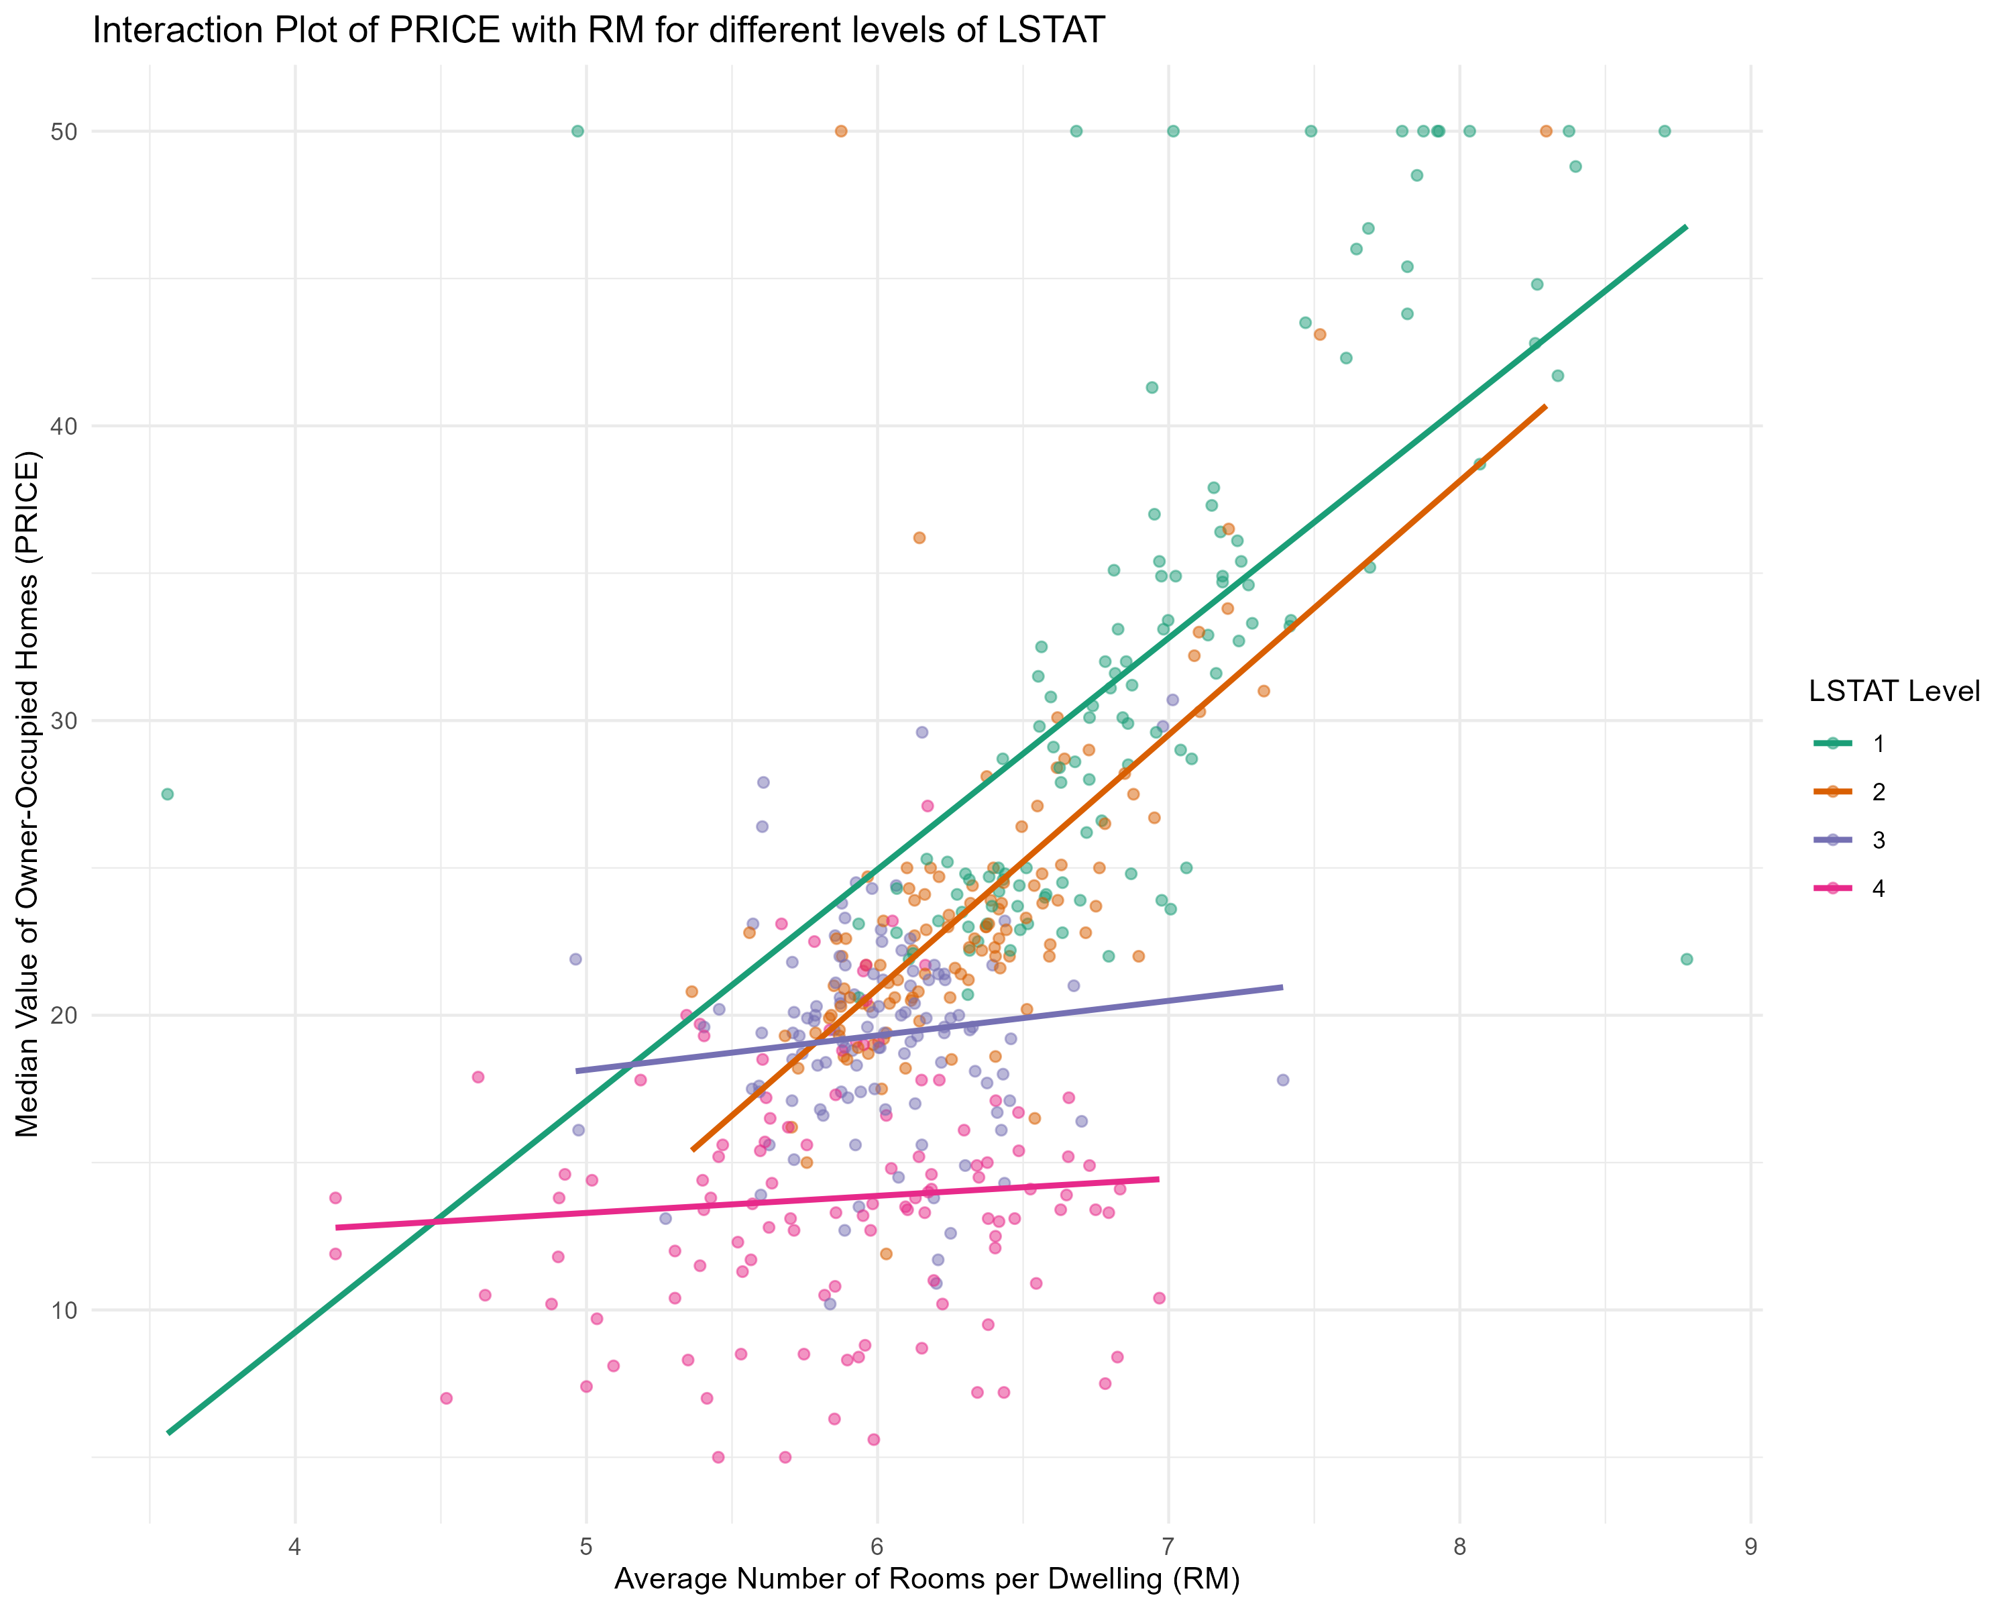
Interaction Plot – RM & LSTAT
LSTAT: % lower status of the population

Slide 14
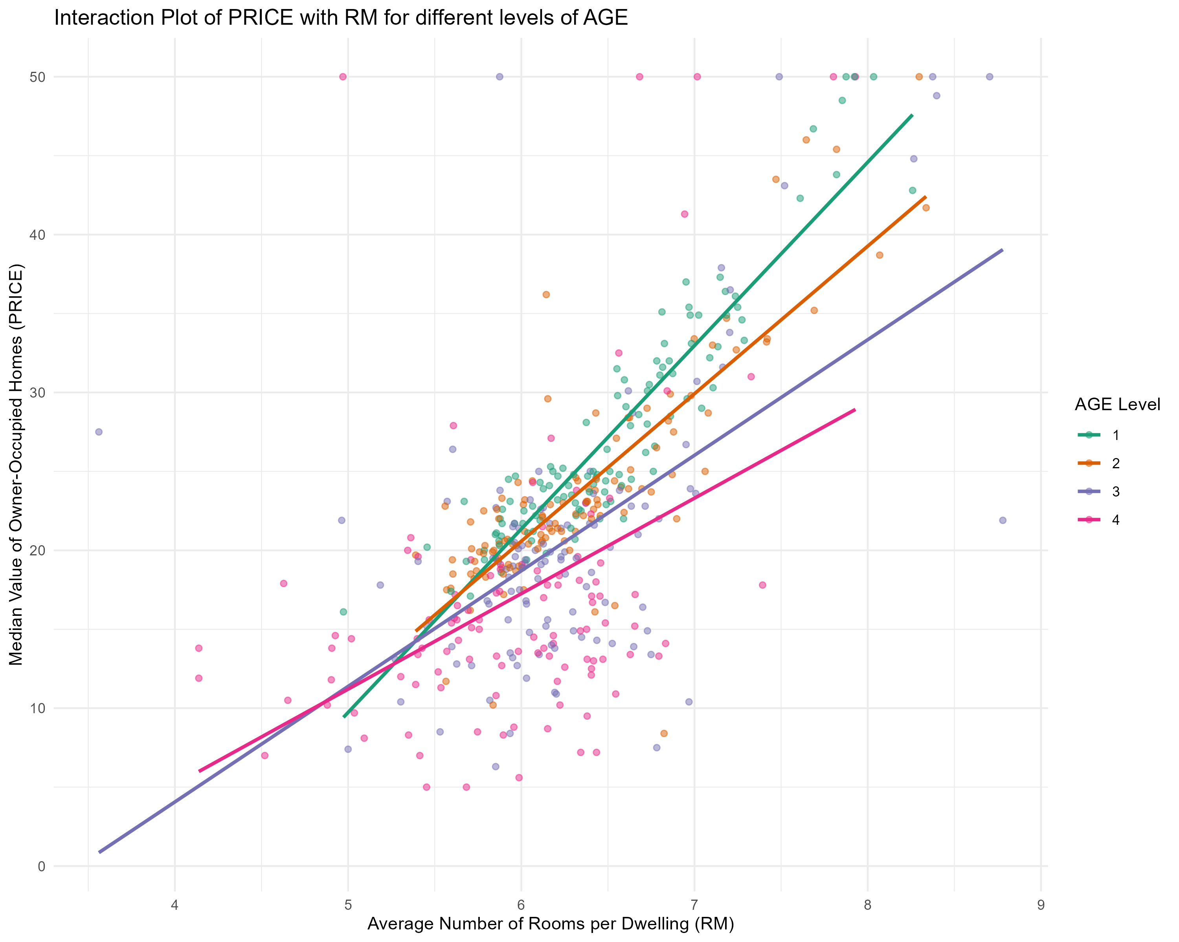
Interaction Plot – AGE & RM

Slide 15
Model Summary
NAME | NOTES | R_{A}² | EXPLANATORY VARIABLES
Fit1 | Full model All 13 variables. | 0.745 | CRIM+ZN+factor(CHAS)+NOX+RM+DIS+RAD+TAX+PTRATIO+B+LSTAT+AGE+INDUS
Fit2 | Stepwise selection Model Remove: INDUS & AGE | 0.7459 | CRIM+ZN+factor(CHAS)+NOX+RM+DIS+RAD+TAX+PTRATIO+B+LSTAT
Fit3 | High order model CRIM, LSTAT & DIS. | 0.8044 | CRIM+ZN+factor(CHAS)+NOX+RM+DIS+RAD+TAX+PTRATIO+B+LSTAT+I(CRIM^2)+I(LSTAT^2)+I(DIS^2)
Fit4 | Interaction model AGE:RM+RM:LSTAT | 0.826 | CRIM+factor(CHAS)+NOX+AGE+RM+DIS+RAD+TAX+PTRATIO+B+LSTAT+I(CRIM^2)+I(LSTAT^2)+I(DIS^2)+AGE:RM+RM:LSTAT
Fit5 | Final model Remove: LSTAT^2 & B | 0.823 | CRIM+factor(CHAS)+NOX+AGE+RM+DIS+RAD+TAX+PTRATIO+LSTAT+I(CRIM^2)+I(DIS^2)+AGE:RM+RM:LSTAT

Slide 16
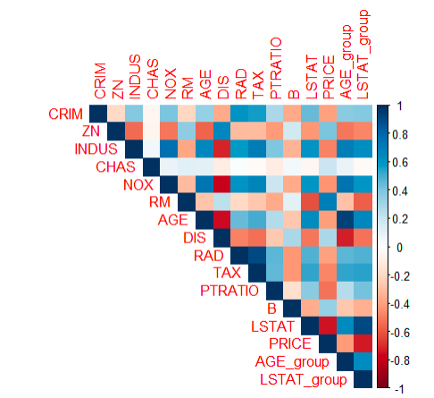
Multicollinearity
We have eliminated the multicollinearity between INDUS~DIS and AGE~DIS after the stepwise process. We decided to keep NOX~DIS as we know both variables are significant in determining the house prices.

Slide 17
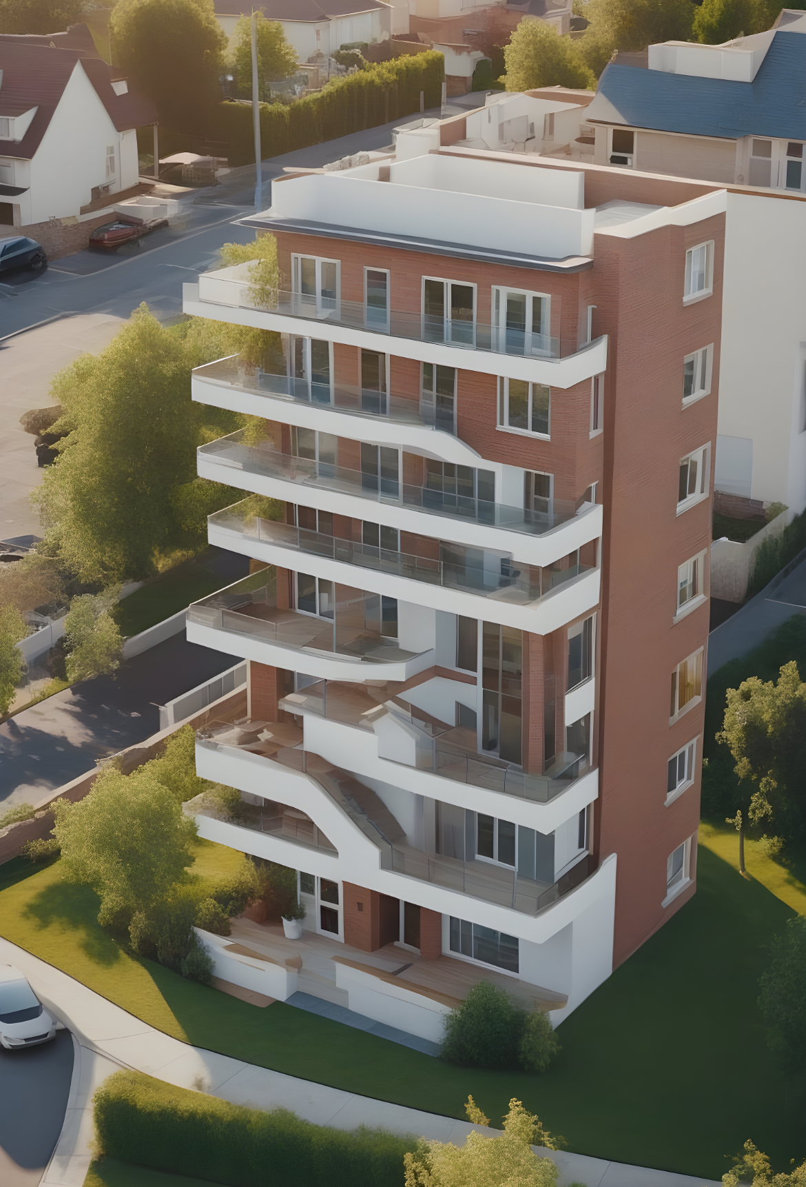
Model Comparison
H0: Reduced Model - β1=β2..=βi=0
Ha: Full Model - At least one of the parameters != 0
Models Compared | Reduced Model | Full Model | Anova P-value | Result | Result
Fit2 ~ Fit1 | Stepwise selection model | Full model | 0.7661 | Fail to reject H0 | Fit 2 is better
Fit2 ~ Fit3 | Stepwise selection model | High order model | < 2.2e-16 | Reject H0 | Fit 3 is better
Fit3 ~ Fit4 | High order model | Interaction model | 2.842e-12 | Reject H0 | Fit 4 is better.
Fit5~Fit4 | Final model | Interaction model | 0.05141 | Fail to reject H0 | Fit 5 is better.

Slide 18
Model Evaluation

Slide 19

Model Evaluation
Fit 5 has the smallest absolute difference when comparing the Actual Price with the Predicted Price and thus is the best prediction model.
 | Absolute Difference
Fit3 | 4.143922
Fit4 | 3.916262
Fit5 | 3.756667

Slide 20
Residual Analysis

Slide 21
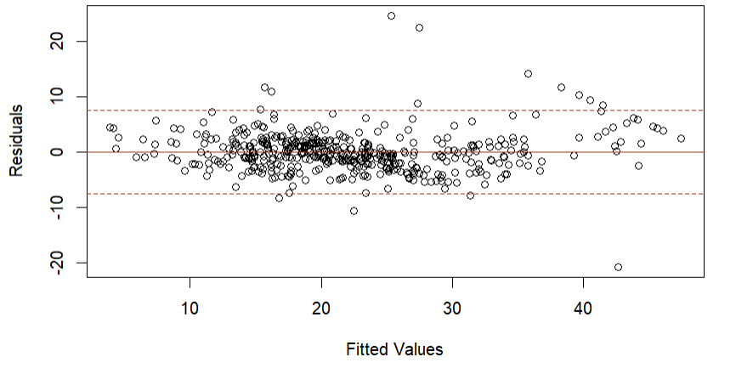
Residual Plot
Estimation of σ²: s = 3.973
We expect the model to provide predictions of House Pricing to be within about ±2s = ±2(3.973) = ±7.946 every unit of pricing. Residual plot shows we have constant variance and no pattern.

Slide 22
Final Model
Predicted Housing Prices = 1.68 – 0.46(CRIM) + 2.75(CHAS:Yes) – 18.20(NOX) + 0.27(AGE) + 10.36(RM) – 3.30(DIS) + 0.40(RAD) – 0.01(TAX) – 0.81(PTRATIO) + 1.60(LSTAT) + 0.004 (CRIM2) + 0.20(DIS2) – 0.04(AGE*RM) – 0.38(RM*LSTAT)
CRIM (-0.46) | For every one-unit increase in the per capita crime rate, the predicted housing price decreases by 0.46 units, assuming all other variables remain constant.
CHAS:Yes (2.75) | If the house borders the Charles River (CHAS is "Yes"), the predicted housing price is 2.75 units higher than if it doesn't border the river, all else being equal.
NOX (-18.20) | For each one-unit increase in nitric oxides concentration, the predicted housing price decreases by 18.20 units, keeping all other variables constant.
AGE (0.27) | For every additional year in the age of the home, the predicted housing price increases by 0.27 units, assuming other variables stay the same.
RM (10.36) | Each additional room in the house is associated with an increase of 10.36 units in the predicted housing price, with all other factors held constant.
DIS (-3.30) | For every one-unit increase in the weighted distances to five Boston employment centers, the predicted housing price decreases by 3.30 units, assuming all else is constant.
RAD (0.40) | Each additional index of accessibility to radial highways is associated with an increase of 0.40 units in the predicted housing price, with all other variables held constant.

Slide 23
Final Model
Predicted Housing Prices = 1.68 – 0.46(CRIM) + 2.75(CHAS:Yes) – 18.20(NOX) + 0.27(AGE) + 10.36(RM) – 3.30(DIS) + 0.40(RAD) – 0.01(TAX) – 0.81(PTRATIO) + 1.60(LSTAT) + 0.004 (CRIM2) + 0.20(DIS2) – 0.04(AGE*RM) – 0.38(RM*LSTAT)
TAX (-0.01) | For every one-unit increase in the full-value property-tax rate per $10,000, the predicted housing price decreases by 0.01 units, assuming all other variables remain constant.
PTRATIO (-0.81) | For each one-unit increase in the pupil-teacher ratio by town, the predicted housing price decreases by 0.81 units, other factors being equal.
LSTAT (1.60) | For each one-unit increase in the percentage of the lower status of the population, the predicted housing price increases by 1.60 units, holding other variables constant.
CRIM^2 (0.004) | As CRIM increases, the impact on housing prices changes by an additional 0.004 units for each unit increase in CRIM, adjusted for the effect of CRIM itself.
DIS^2 (0.20) | The housing prices changes by 0.20 units for each unit increase in DIS, considering the linear effect of DIS.
AGE * RM (-0.04) | The effect of the age of the home on the predicted housing prices changes by -0.04 units for each additional room, implying that the positive effect of additional rooms diminishes as the house gets older.
RM * LSTAT (-0.38) | The effect of the number of rooms (RM) on housing prices is reduced by 0.38 units for each additional unit of LSTAT. This suggests that the positive impact of having more rooms is less in areas with a higher proportion of lower status population.

Slide 24
Testing Utility of the Model

Slide 25
Multiple Coefficients of Determination: R_{a}²
About 82% of the total sample variation in Housing Price (y) is explained by the model; the remainder is explained by random error.
R_{a}² : 0.822546

Slide 26
Anova F-Test
H0: β1 = β2 = ... βi = 0 - Model is not adequate in predicting the housing prices
Ha: At least one βi != 0 - Model is adequate in predicting the housing prices
F-statistic: 151.4 (F-statistic on fit5) P-value: < 2.2e-16
At 1% level of significance, we reject the H0. The data provide strong evidence to conclude that the model is useful in predicting the House Prices.

Slide 27
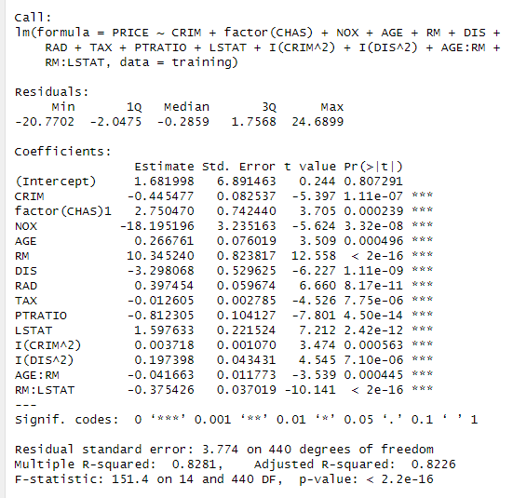
Testing Individual Parameter

Slide 28
Prediction & Confidence Interval

Slide 29
Prediction & Confidence Interval
CRIM | 0.63
CHAS | factor(0)
NOX | 0.52
AGE | 60
RM | 5
DIS | 4.5
RAD | 4
TAX | 307
PTRATIO | 21
LSTAT | 5.5
Prediction Interval
Fitted | PI:LB | PI:UB
15.45467 | 7.89914 | 23.0102
Confidence Interval
Fitted | CI:LB | CI:UB
15.45467 | 14.01744 | 16.8919

Slide 30
Conclusion
What factors have the most significant impact on the median value of homes in the Boston area?
Which predictive model most accurately forecasts housing prices based on the available dataset features?
CRIM, CHAS, NOX, AGE, RM, DIS, RAD, TAX, PTRATIO
Fit 5
Predicted Housing Prices = 1.68 – 0.46(CRIM) + 2.75(CHAS:Yes) – 18.20(NOX) + 0.27(AGE) + 10.36(RM) – 3.30(DIS) + 0.40(RAD) – 0.01(TAX) – 0.81(PTRATIO) + 1.60(LSTAT) + 0.004 (CRIM2) + 0.20(DIS2) – 0.04(AGE*RM) – 0.38(RM*LSTAT)

Slide 31
Thanks!

